Slide 1
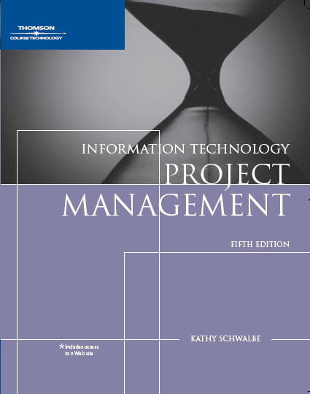
Chapter 6:
Project Time Management
Information Technology Project Management,
Fifth Edition
Note: some slides have been removed
from the author’s original presentation.

Slide 2
Importance of Project Schedules
  Managers often cite delivering projects on time as one of their biggest challenges
Time has the least amount of flexibility; it passes no matter what happens on a project
  Schedule issues are the main reason for conflicts on projects, especially during the second half of projects
Information Technology Project Management, Fifth Edition, Copyright 2007

Slide 3
Project Time Management Processes
Activity definition: identifying the specific activities that the project team members and stakeholders must perform to produce the project deliverables
Activity sequencing: identifying and documenting the relationships between project activities
Activity resource estimating: estimating how many resources a project team should use to perform project activities
Activity duration estimating: estimating the number of work periods that are needed to complete individual activities
Schedule development: analyzing activity sequences, activity resource estimates, and activity duration estimates to create the project schedule
Schedule control: controlling and managing changes to the project schedule
Information Technology Project Management, Fifth Edition, Copyright 2007

Slide 4
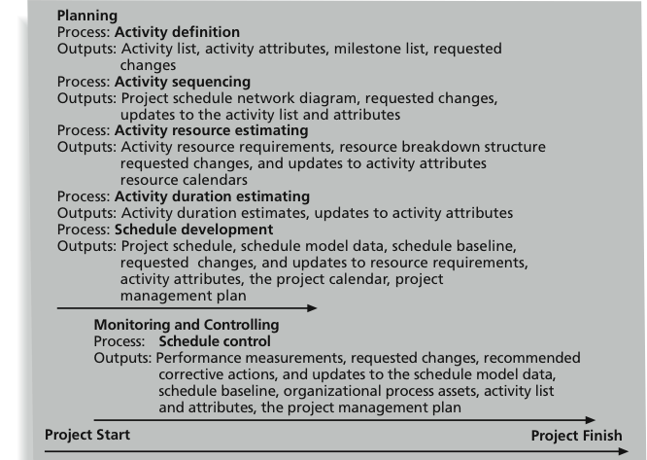
Figure 6-1: Project Time Management Summary
Information Technology Project Management, Fifth Edition, Copyright 2007

Slide 5
1. Activity Definition
Project schedules grow out of the basic documents that initiate a project
  Project charter includes start and end dates and budget information
  Scope statement and WBS help define what will be done
Activity definition involves developing a more detailed WBS and supporting explanations to understand all the work to be done so you can develop realistic cost and duration estimates
Information Technology Project Management, Fifth Edition, Copyright 2007

Slide 6
Activity Lists and Attributes
An activity list is a tabulation of activities to be included on a project schedule that includes:
  The activity name
  An activity identifier or number
  A brief description of the activity
Activity attributes provide more information such as predecessors, successors, logical relationships, leads and lags, resource requirements, constraints, imposed dates, and assumptions related to the activity
Information Technology Project Management, Fifth Edition, Copyright 2007

Slide 7
2. Activity Sequencing
Involves reviewing activities and determining dependencies
A dependency or relationship is the sequencing of project activities or tasks
You must determine dependencies in order to use critical path analysis
Information Technology Project Management, Fifth Edition, Copyright 2007

Slide 8
Three Types of Dependencies
Mandatory dependencies: inherent in the nature of the work being performed on a project, sometimes referred to as hard logic
Discretionary dependencies: defined by the project team; sometimes referred to as soft logic and should be used with care since they may limit later scheduling options
External dependencies: involve relationships between project and nonproject activities
Information Technology Project Management, Fifth Edition, Copyright 2007

Slide 9
Network Diagrams
Network diagrams are the preferred technique for showing activity sequencing
A network diagram is a schematic display of the logical relationships among, or sequencing of, project activities
Two main formats are the arrow and precedence diagramming methods
Information Technology Project Management, Fifth Edition, Copyright 2007

Slide 10
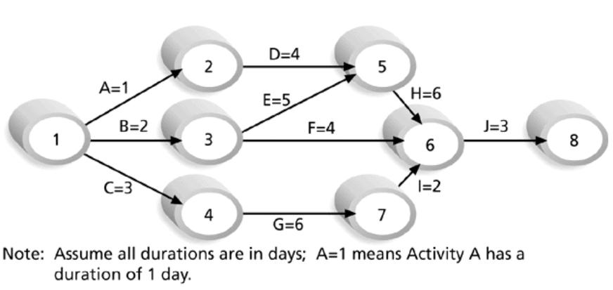
Figure 6-2: Sample Activity-on-Arrow (AOA) Network Diagram for Project X
Information Technology Project Management, Fifth Edition, Copyright 2007

Slide 11
Arrow Diagramming Method (ADM)
Also called activity-on-arrow (AOA) network diagrams
Activities are represented by arrows
Nodes or circles are the starting and ending points of activities
Can only show finish-to-start dependencies
Information Technology Project Management, Fifth Edition, Copyright 2007

Slide 12
Process for Creating AOA Diagrams
1. Find all of the activities that start at node 1: Draw their finish nodes and draw arrows between node 1 and those finish nodes; put the activity letter or name and duration estimate on the associated arrow
2. Continue drawing the network diagram, working from left to right: Look for bursts and merges
  Bursts occur when a single node is followed by two or more activities
  A merge occurs when two or more nodes precede a single node
3. Continue drawing the project network diagram until all activities are included on the diagram that have dependencies
4. As a rule of thumb, all arrowheads should face toward the right, and no arrows should cross on an AOA network diagram
Information Technology Project Management, Fifth Edition, Copyright 2007

Slide 13
Precedence Diagramming Method (PDM)
Activities are represented by boxes
Arrows show relationships between activities
More popular than ADM method and used by project management software
Better at showing different types of dependencies
Information Technology Project Management, Fifth Edition, Copyright 2007

Slide 14
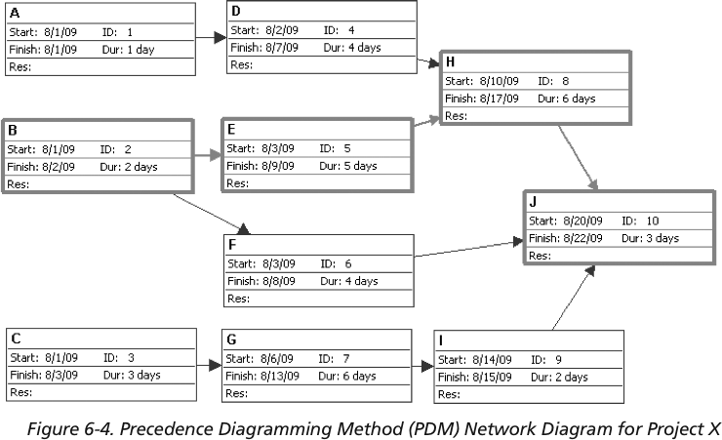
Figure 6-4: Sample PDM Network Diagram
Information Technology Project Management, Fifth Edition, Copyright 2007

Slide 15
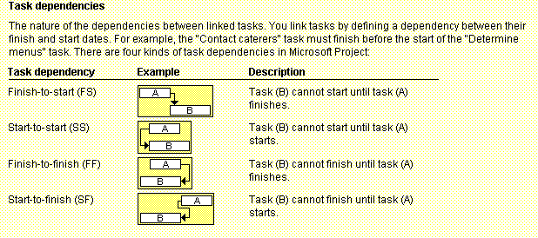
Figure 6-3: Task Dependency Types
Information Technology Project Management, Fifth Edition, Copyright 2007

Slide 16
Leads and Lags
You may define leads and lags for dependant tasks
Lead – the amount of overlapping time for 2 dependant tasks
  Used when the dependant task may start when its predecessor is for example a half complete
Lag – is a time gap between 2 dependant tasks
  Used as a reserved time before critical milestones
Information Technology Project Management, Fifth Edition, Copyright 2007

Slide 17
3. Activity Resource Estimating
Before estimating activity durations, you must have a good idea of the quantity and type of resources that will be assigned to each activity
Consider important issues in estimating resources
  How difficult will it be to do specific activities on this project?
  What is the organization’s history in doing similar activities?
  Are the required resources available?
A resource breakdown structure is a hierarchical structure that identifies the project’s resources by category and type
Information Technology Project Management, Fifth Edition, Copyright 2007

Slide 18
4. Activity Duration Estimating
Duration includes the actual amount of time worked on an activity plus elapsed time
Effort is the number of workdays or work hours required to complete a task
Effort does not normally equal duration
People doing the work should help create estimates, and an expert should review them
Information Technology Project Management, Fifth Edition, Copyright 2007

Slide 19
Three-Point Estimates
Instead of providing activity estimates as a discrete number, such as four weeks, it’s often helpful to create a three-point estimate
  An estimate that includes an optimistic, most likely, and pessimistic estimate, such as three weeks for the optimistic, four weeks for the most likely, and five weeks for the pessimistic estimate

Slide 20
5. Schedule Development
Uses results of the other time management processes to determine the start and end date of the project
Ultimate goal is to create a realistic project schedule that provides a basis for monitoring project progress for the time dimension of the project
Important tools and techniques include Gantt charts, critical path analysis, critical chain scheduling, and PERT analysis
Information Technology Project Management, Fifth Edition, Copyright 2007

Slide 21
Gantt Charts
Gantt charts provide a standard format for displaying project schedule information by listing project activities and their corresponding start and finish dates in a calendar format
Symbols include:
  Black diamonds: milestones
  Thick black bars: summary tasks
  Lighter horizontal bars: durations of tasks
  Arrows: dependencies between tasks
Information Technology Project Management, Fifth Edition, Copyright 2007

Slide 22
Milestones
A milestone is a significant event that normally has no duration
It often takes several activities and a lot of work to complete a milestone
They’re useful tools for setting schedule goals and monitoring progress
Examples include obtaining customer sign-off on key documents or completion of specific products
Information Technology Project Management, Fifth Edition, Copyright 2007

Slide 23
Adding Milestones to Gantt Charts
Many people like to focus on meeting milestones, especially for large projects
Milestones emphasize important events or accomplishments on projects
Normally create milestone by entering tasks with a zero duration, or you can mark any task as a milestone
Information Technology Project Management, Fifth Edition, Copyright 2007

Slide 24
SMART Criteria
Milestones should be:
  Specific
  Measurable
  Assignable
  Realistic
  Time-framed
Information Technology Project Management, Fifth Edition, Copyright 2007

Slide 25
Best Practice
Schedule risk is inherent in the development of complex systems
Luc Richard, the founder of www.projectmangler.com, suggests that project managers can reduce schedule risk through project milestones, a best practice that involves identifying and tracking significant points or achievements in the project
Information Technology Project Management, Fifth Edition, Copyright 2007

Slide 26
Best Practice (continued)
The five key points of using project milestones include the following:
  1. Define milestones early in the project and include them in the Gantt chart to provide a visual guide
  2. Keep milestones small and frequent
  3. The set of milestones must be all-encompassing
  4. Each milestone must be binary, meaning it is either complete or incomplete
  5. Carefully monitor the critical path
Information Technology Project Management, Fifth Edition, Copyright 2007

Slide 27
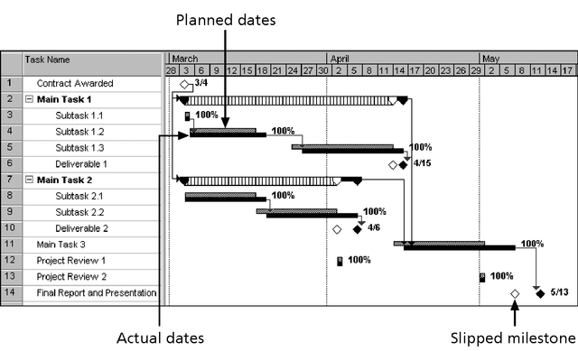
Figure 6-7: Sample Tracking Gantt Chart
Information Technology Project Management, Fifth Edition, Copyright 2007

Slide 28
Critical Path Method (CPM)
CPM is a network diagramming technique used to predict total project duration
A critical path for a project is the series of activities that determines the earliest time by which the project can be completed
The critical path is the longest path through the network diagram and has the least amount of slack or float
Slack or float is the amount of time an activity may be delayed without delaying a succeeding activity or the project finish date
Information Technology Project Management, Fifth Edition, Copyright 2007

Slide 29
Calculating the Critical Path
First develop a good network diagram
Add the duration estimates for all activities on each path through the network diagram
The longest path is the critical path
If one or more of the activities on the critical path takes longer than planned, the whole project schedule will slip unless the project manager takes corrective action
Information Technology Project Management, Fifth Edition, Copyright 2007

Slide 30
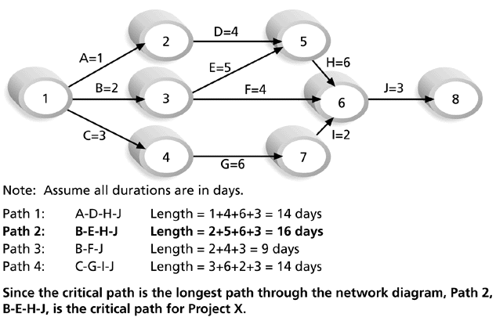
Figure 6-8: Determining the Critical Path for Project X
Information Technology Project Management, Fifth Edition, Copyright 2007

Slide 31
More on the Critical Path
The critical path is not the one with all the critical activities; it only accounts for time
There can be more than one critical path if the lengths of two or more paths are the same
The critical path can change as the project progresses
Use leads and lags as the input for slacks analysis
Information Technology Project Management, Fifth Edition, Copyright 2007

Slide 32
Using Critical Path Analysis to Make Schedule Trade-offs
Free slack or free float is the amount of time an activity can be delayed without delaying the early start of any immediately following activities
Total slack or total float is the amount of time an activity may be delayed from its early start without delaying the planned project finish date
A forward pass through the network diagram determines the early start and finish dates
A backward pass determines the late start and finish dates
Information Technology Project Management, Fifth Edition, Copyright 2007

Slide 33
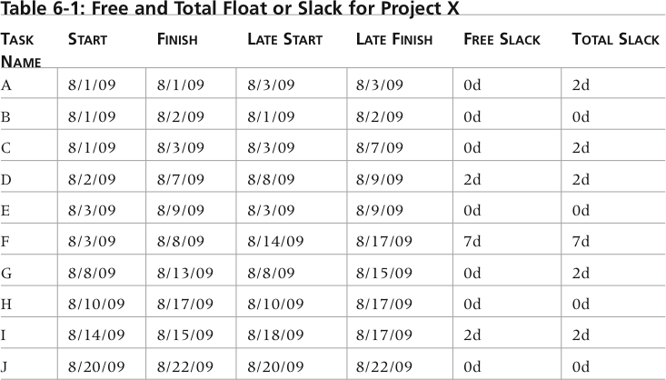
Table 6-1: Free and Total Float or Slack for Project X
Information Technology Project Management, Fifth Edition, Copyright 2007

Slide 34
Using the Critical Path to Shorten a Project Schedule
Three main techniques for shortening schedules
  Shortening durations of critical activities/tasks by adding more resources or changing their scope
    Not always possible
    When the greatest amount of schedule compression is achieved for the least incremental cost, this is known as Crashing
  Fast tracking activities by doing them in parallel or overlapping them based on task leads
Information Technology Project Management, Fifth Edition, Copyright 2007

Slide 35
Importance of Updating Critical Path Data
It is important to update project schedule information to meet time goals for a project
The critical path may change as you enter actual start and finish dates
If you know the project completion date will slip, negotiate with the project sponsor
Information Technology Project Management, Fifth Edition, Copyright 2007

Slide 36
Buffers and Critical Chain
A buffer is additional time to complete a task
Murphy’s Law states that if something can go wrong, it will
Parkinson’s Law states that work expands to fill the time allowed
In traditional estimates, people often add a buffer to each task and use it if it’s needed or not
Critical chain scheduling removes buffers from individual tasks and instead creates:
  A project buffer or additional time added before the project’s due date
  Feeding buffers or additional time added before tasks on the critical path
Information Technology Project Management, Fifth Edition, Copyright 2007

Slide 37
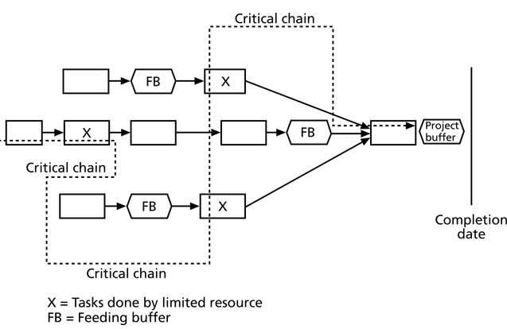
Figure 6-11: Example of Critical Chain Scheduling
Information Technology Project Management, Fifth Edition, Copyright 2007

Slide 38
Time management for security projects
The same approach and technique
Something to keep in mind:
  Security projects often require communication with stakeholders who may have different visions to the project. Allocate sufficient time for this sort of communication
  Many companies have their standards for work efforts required to complete technical activities, such as installation, configuration etc.
  Vendor selecting activity is time consuming, and may take up to 6 mos, or even longer
Information Technology Project Management, Fifth Edition, Copyright 2007

